Slide 1


Python Project
TITLE: Village data info hub
Name: Vemireddy Venkatarami Reddy
Section: K23UP
Registration No: 12307726
Roll No: 47
Group : G2
Course Code: CSM216
Course Name: Python Project
Submitted To:
Aman Kumar

Slide 2
Introduction: Content: Purpose: To manage village data with roles for DEOs and Village Officials. Key Features: Login functionality for different roles. Add and manage family and family member data.

Slide 3
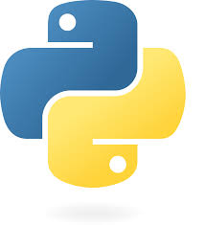

Technology Stack:
Frontend: Python's Tkinter library.
Backend: MySQL database for data storage.
Libraries:
tkinter for GUI.
mysql.connector for database connectivity.
Programming Language: Python.

Slide 4
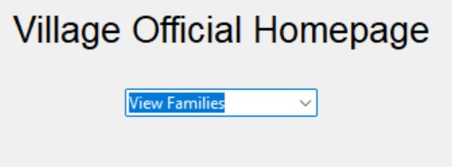
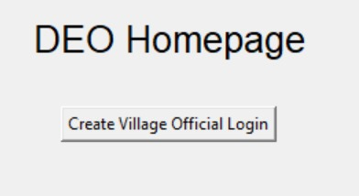
System Workflow:
User Login:
DEOs and Village Officials log in using their credentials.
Homepages:
DEO: Manage village official logins.
Village Official: Manage families and members.
Database Operations:
Add/View family and member data.

Slide 5
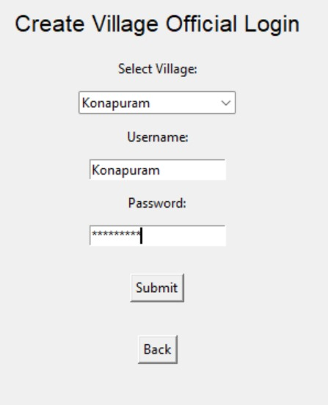
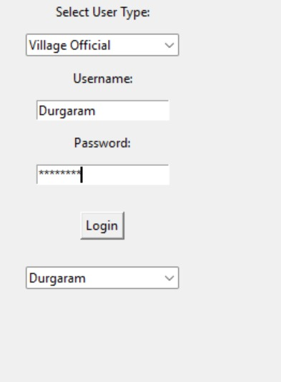
Key Functionalities:
Login System:
DEO and Village Official roles.
DEO Dashboard:
Create logins for village officials.
Village Official Dashboard:
Add/View families and family members.
Database Integration:
Securely manage village-related data.

Slide 6
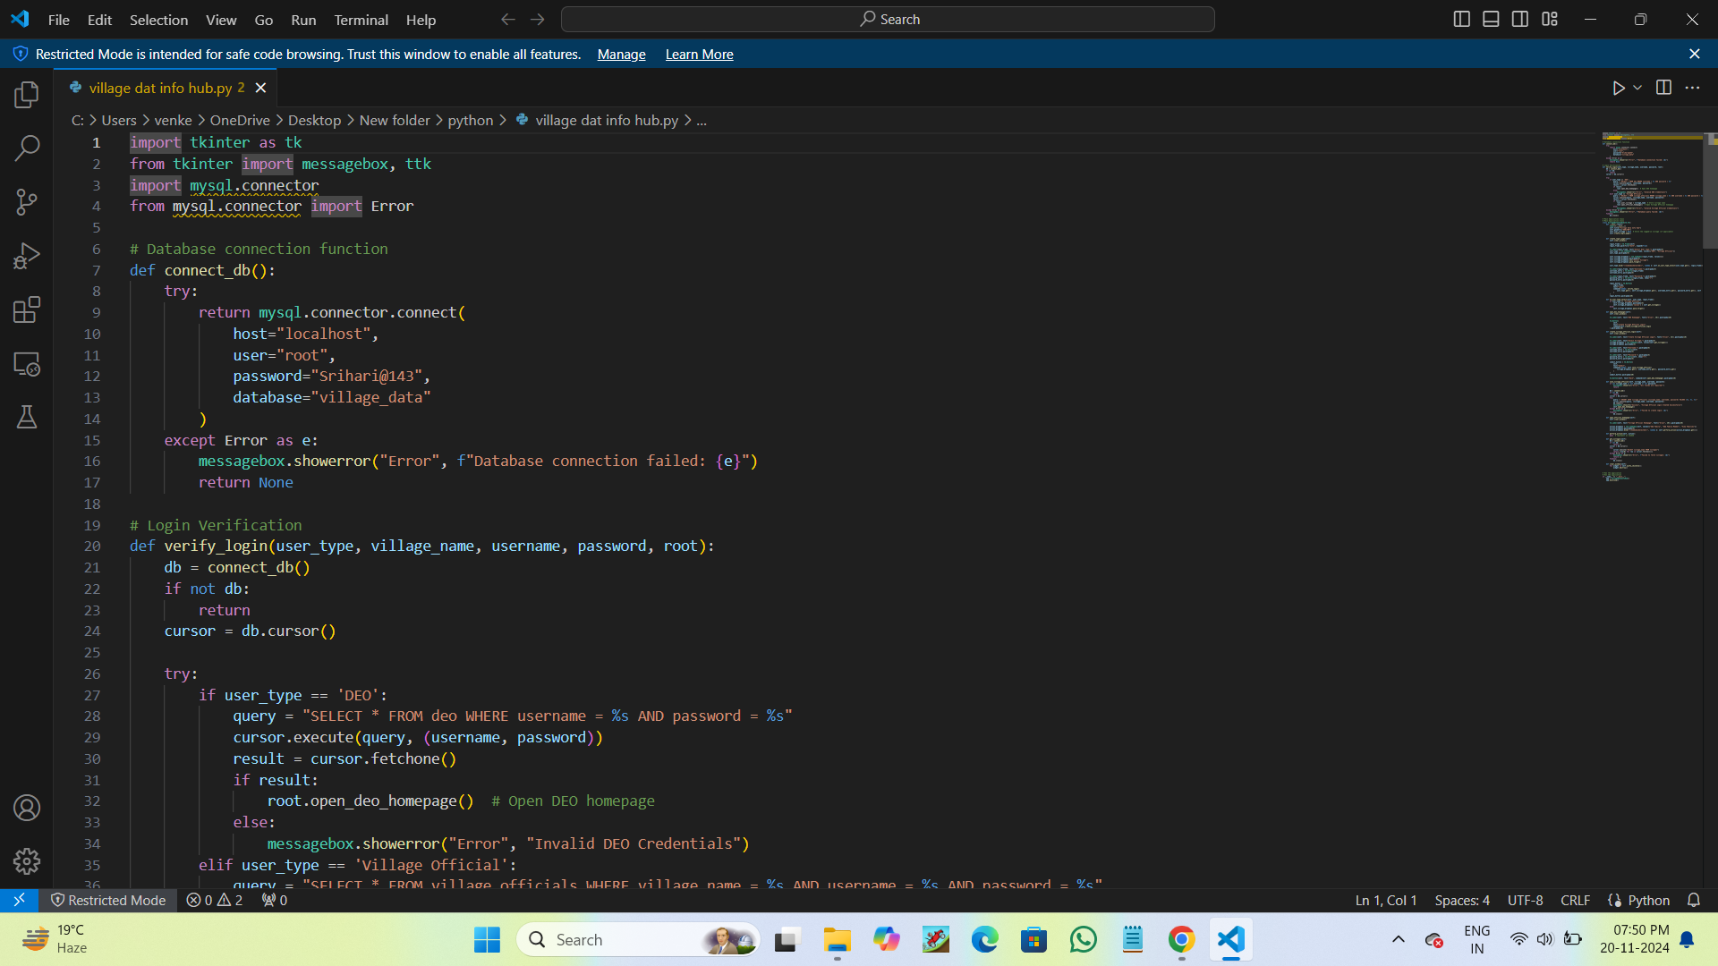
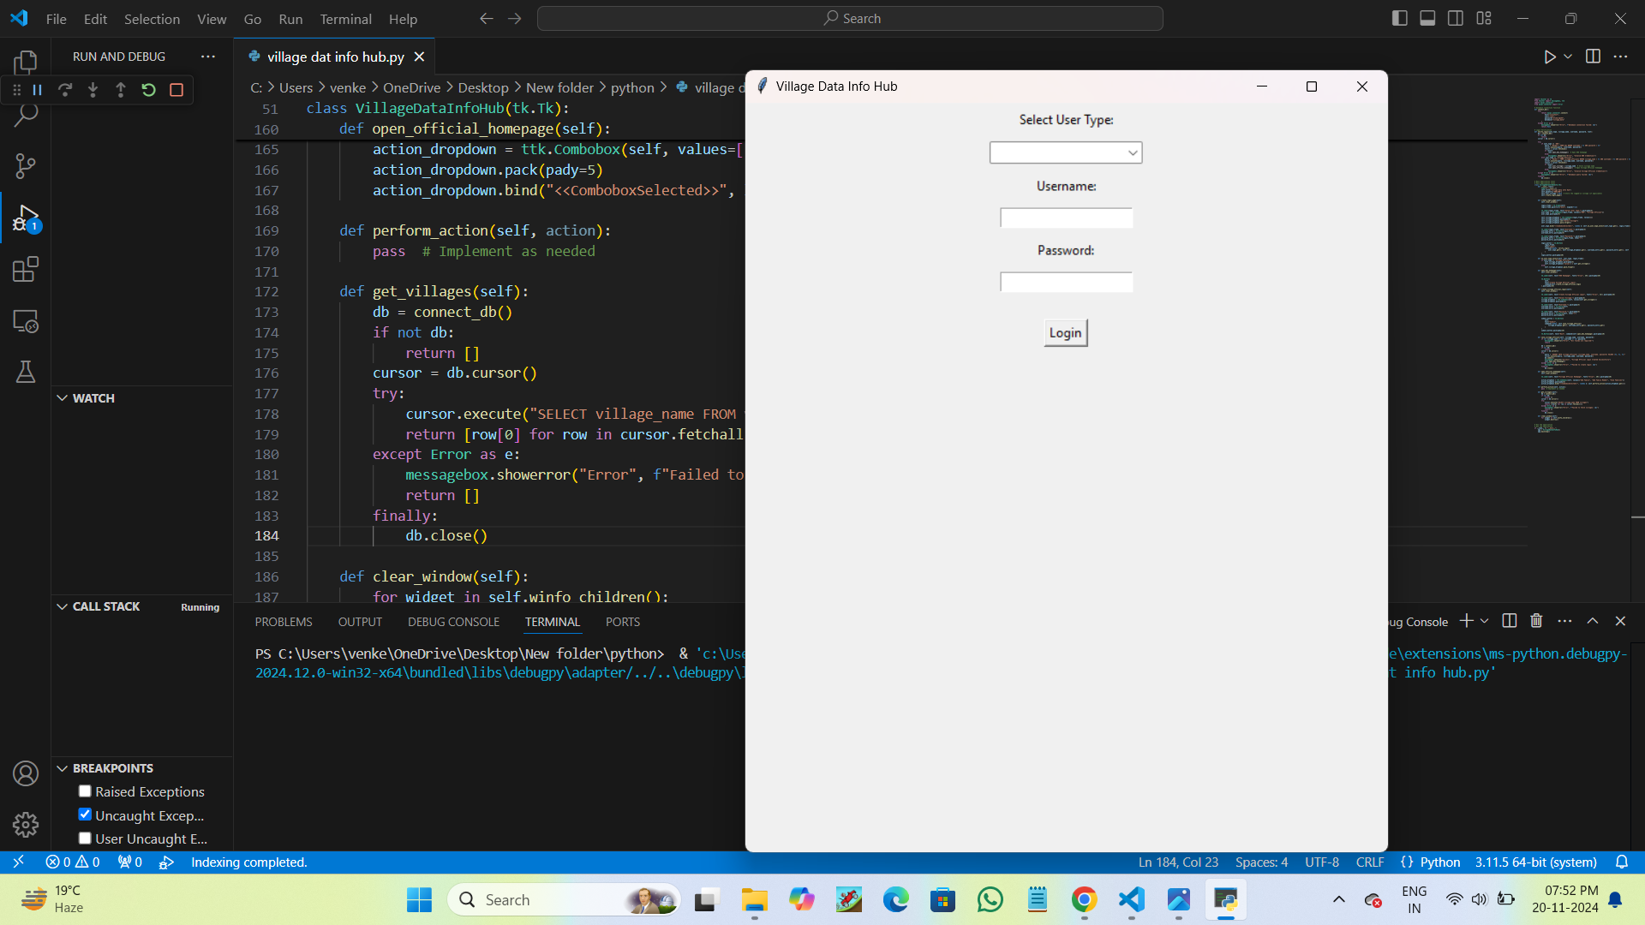
Code Structure:
Main Application Class:
VillageDataInfoHub – Handles UI and navigation
Data Connection Function:
connect_db() – Establishes a MySQL connection
Login Verification:
Verify_login() - Validates user credentials.
CRUD Operations:
Methods for adding and viewing families and members

Slide 7
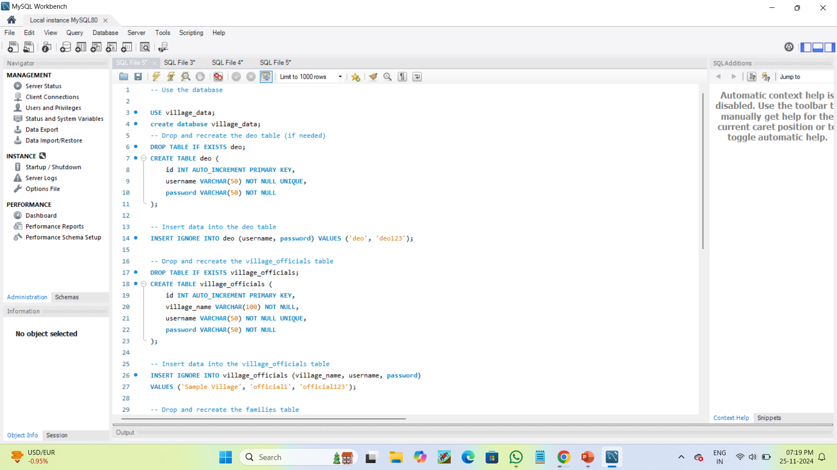
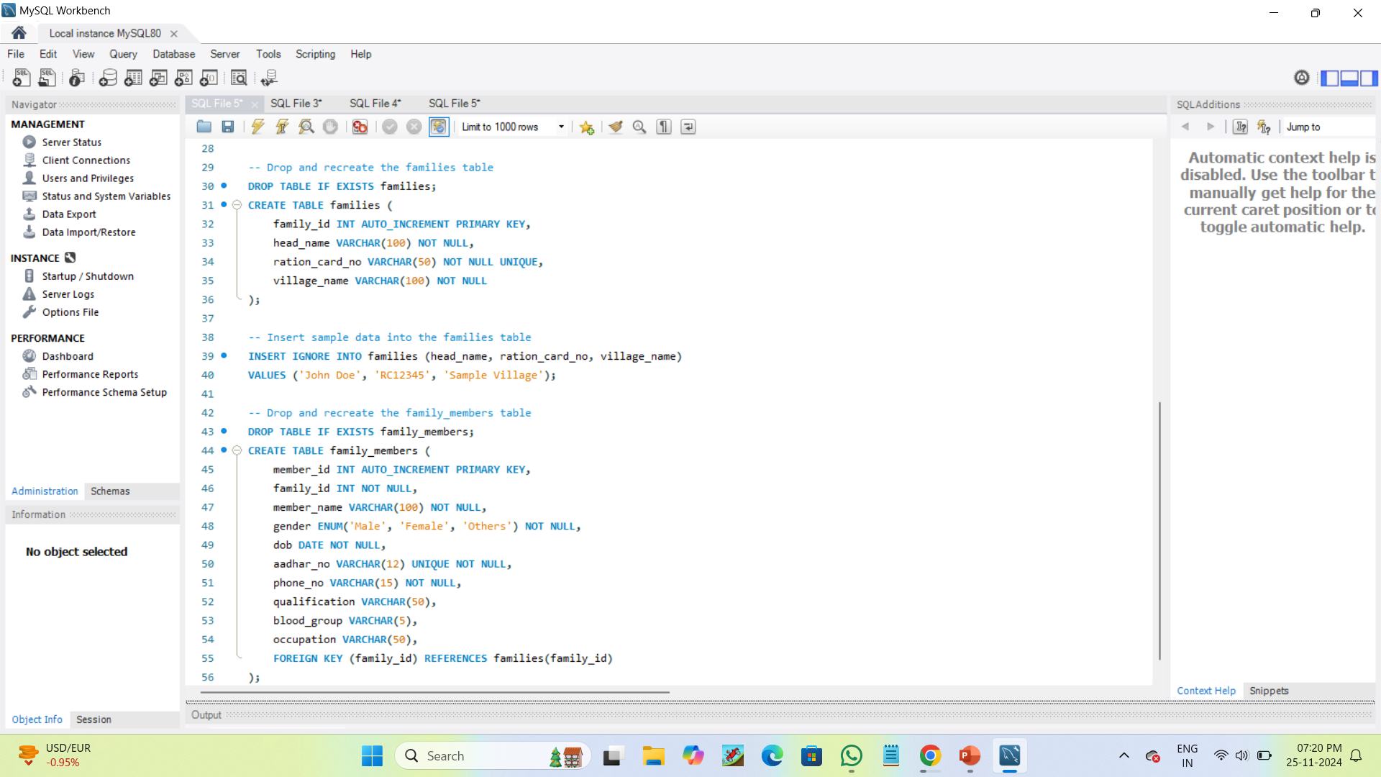
Database Design:
Tables:
villages: Stores village information.
deo: Stores DEO login details.
village_officials: Stores village official credentials.
families: Stores family data.
family_members: Stores details of family members.
Relationships:.
villages ↔ families (One-to-Many).
families ↔ family_members (One-to-Many).

Slide 8
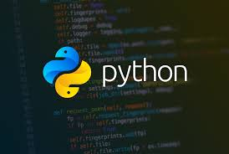
Challenge: Handling database connection errors. Solution: Added error handling in database operations Challenge: User-friendly navigation. Solution: Designed clear workflows for both user roles.
Challenges and Solutions
Future Enhancements
Add data visualization for better insights.
Implement advanced search and filtering features.
Enhance security with hashed passwords and role-based access.
Migrate to a web-based platform for wider accessibility.

Slide 9
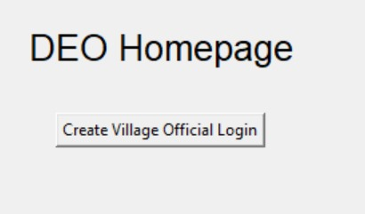
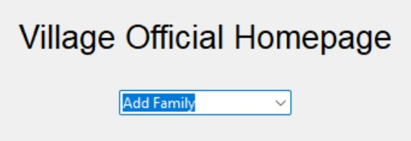
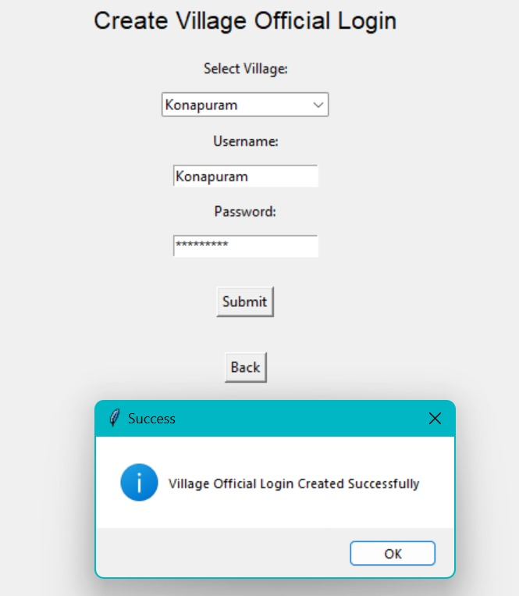
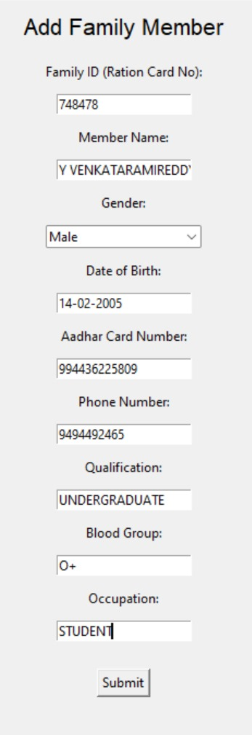
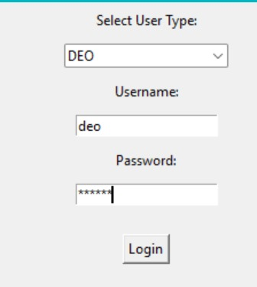
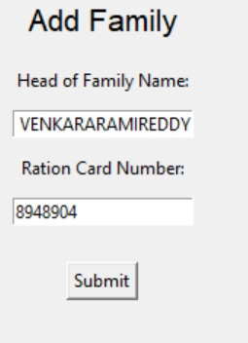
OUTPUTS OF THE CODE:

Slide 10
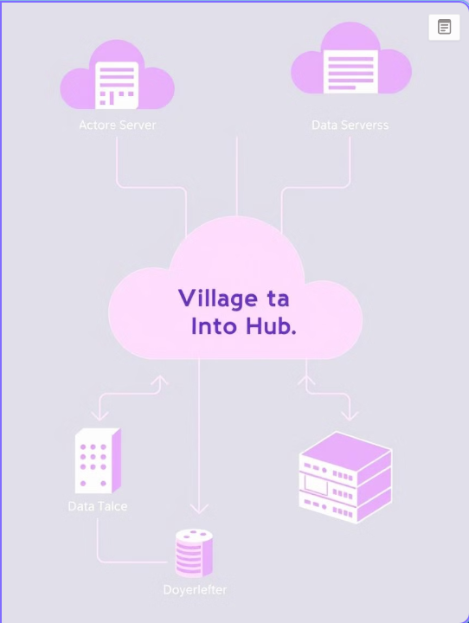
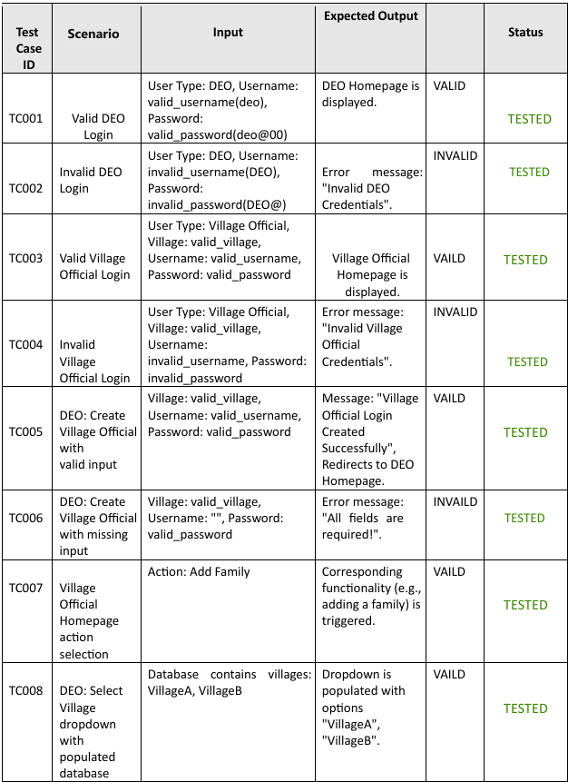
Test Cases:

Slide 11
Conclusion:
The Village Data Info Hub simplifies village-level data management.
Built using Python and MySQL for a robust backend.
Flexible design allows easy scalability.
The Village Data Info Hub is a streamlined and user-friendly application designed to manage village-level data efficiently. Built with Python’s Tkinter for GUI and MySQL for database management, it facilitates secure user authentication, data entry, and retrieval for DEOs and Village Officials.

Slide 12


